Slide 1

What is a university? Critical reflections on the nature and future of higher education
Tristan McCowan (UCL)
Distinguished Scholar Seminar Series, Lingnan University
15 November 2023

Slide 2
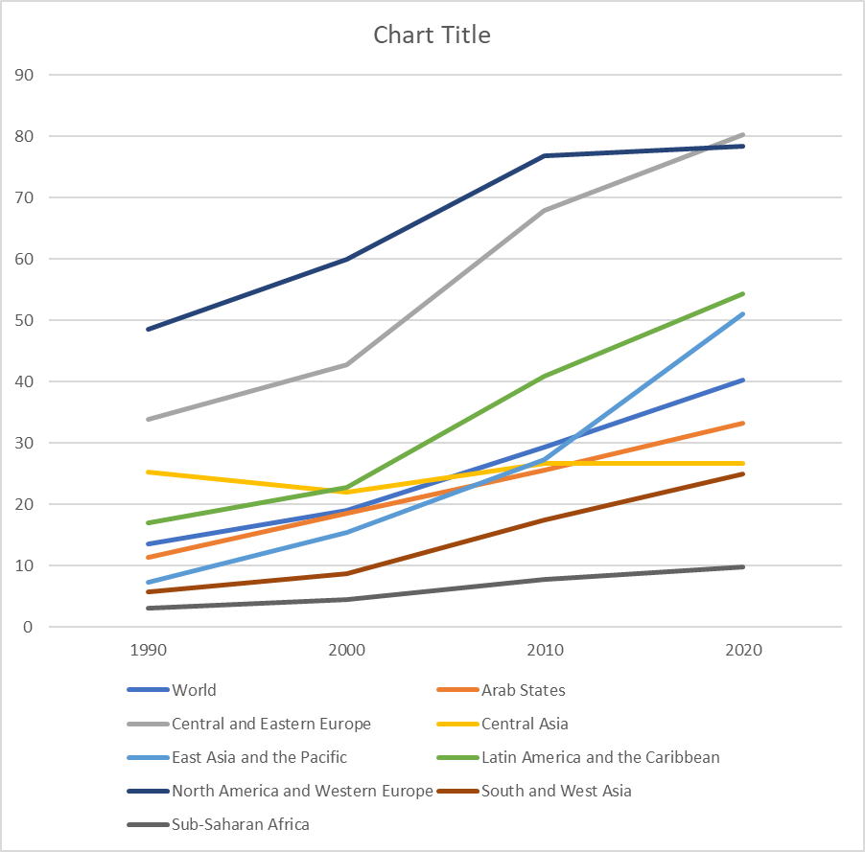
Gross enrolment ratios in tertiary education, by region
hhhhhhhhhhhhhh
(UIS 2023)

Slide 3
Technical definitions
‘all types of studies, training or training for research at the post-secondary level, provided by universities or other educational establishments that are approved as institutions of higher education by the competent State authorities’ (UNESCO 1993)

Slide 4
Technical definitions
“All types of education (academic, professional, technical, artistic, pedagogical, long distance learning, etc.) provided by universities, technological institutes, teacher training colleges, etc., which are normally intended for students having completed a secondary education, and whose educational objective is the acquisition of a title, a grade, certificate, or diploma of higher education”.
(UNESCO 2019)

Slide 5
Technical definitions
University, higher education and tertiary education
Teaching, research and community engagement
University/polytechnic distinction
TVET and community colleges
University/specialist college distinction

Slide 6
Where is the university?
Adults
Research
Specialisation
Depth
Professional licence

Slide 7
Normative conceptions of the university
Humboldt - the research university
Newman – cultivation of the intellect
Oakeshott – university as conversation
Barnet – ecological university
Selingo – networked university

Slide 8
“extending human understanding through open-ended enquiry”
(Collini 2012)

Slide 9
Discussion:
In your view, what constitutes a university?

Slide 10

Nalanda

Slide 11

University of
Al-Qarawiyyin

Slide 12

Medieval
University lecture, from a painting by Laurentius de Voltolina, 1350

Slide 13
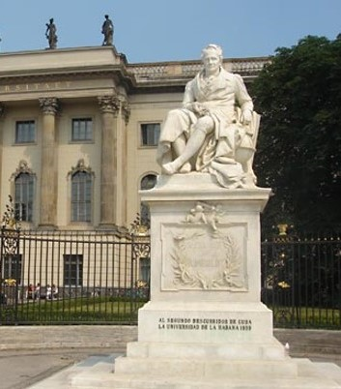
Humboldtian
University of Berlin, est. 1810 (now Humboldt University)

Slide 14

Developmental
University for Development Studies, Tamale, Ghana

Slide 15
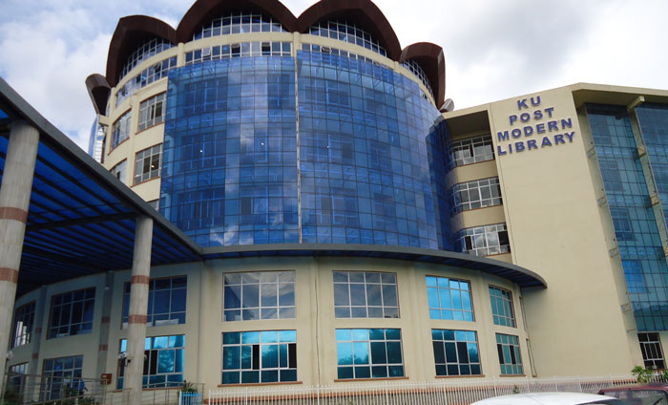
Entrepreneurial
Kenyatta University, Nairobi

Slide 16
The world’s largest universities (estimates)
Indira Gandhi National Open University (India) 7.1 million
Bangladesh National University (public system) 2 million
Anadolu University (Turkey, public system) 2 million
Allama Iqbal Open University (Pakistan) 1 million
Islamic Azad University (Iran, private chain) 1 million
Bangladesh Open University 650,000
Universitas Terbuk (Indonesia, open) 650,000
Notes:
https://www.youtube.com/watch?v=KqQNvmQH_YM

Slide 17


Slide 18
The unbundled university
Loci:
  System
  Institution
  Course
  Academic staff
Features:
  Outsourcing of services
  Para-academics
  MOOCs
  Distance/blended learning
  Trans-locational
  External validation of skills
  The end of the programme of study
  From academics to stars and tutors

Slide 19
Modes of unbundling in higher education
Disaggregation
No-frills
Deinstitutionalisation
(McCowan 2017)

Slide 20

Reaching the excluded?
Unbundling and rebundling

Slide 21
Learning
Credentials

Slide 22
Deinstitutionalisation
Gates
Roles
Badges
(McCowan 2022)

Slide 23


Slide 24


